Slide 1
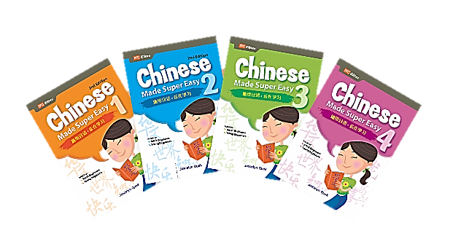
Chinese Made Super Easy Series
(Book 1-4)
(11-18 years old)
这系列的4本书的内容从浅白的单字到较长的句子，系统化地让读者轻松掌握汉语。读者可利用这系列的书来自习，加强说华语的能力，也适合作为课本以外的辅助教材。
The books in the series enable readers to learn conversational Mandarin in a systematic and effective way. They can be used for self-study or as supplementary materials in classroom teaching.

Slide 2
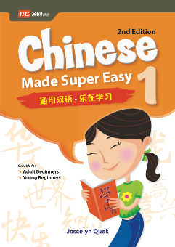
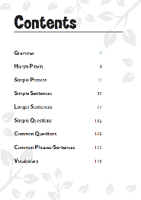
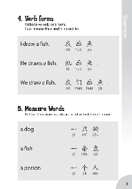
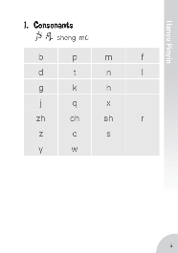
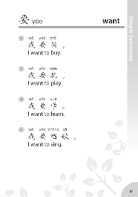
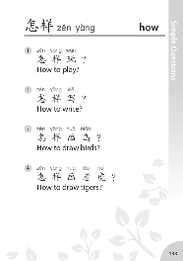
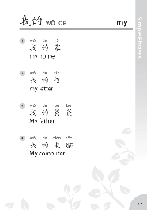
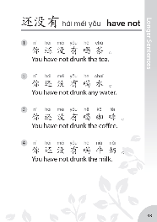
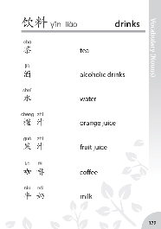

Slide 3
